Slide 1
TLS
CS 161 Fall 2022 - Lecture 19

Slide 2
Last Time: TCP and UDP
Transmission Control Protocol (TCP): Reliably sending packets
3-way handshake: Client sends SYN, server sends SYN-ACK, client sends ACK
Provides reliability, ordering, and ports
Attack: TCP hijacking through data injection or RST injection
Blind attacks must guess the client’s or server’s sequence numbers
Attack: TCP spoofing by sending a spoofed SYN packet
Blind attacks must guess the server’s sequence number
User Datagram Protocol (UDP): Non-reliably sending packets
No reliability or ordering, only ports
Same injection and spoofing attacks as TCP, but easier

Slide 3
TLS
Textbook Chapter 31

Slide 4
TLS
TLS (Transport Layer Security): A protocol for creating a secure communication channel over the Internet
Replaces SSL (Secure Sockets Layer), which is an older version of the protocol
TLS is built on top of TCP
Relies upon: Byte stream abstraction between the client and the server
Provides: Byte stream abstraction between the client and the server
The abstraction appears the same to the end client, but TLS provides confidentiality and integrity!
7
Application
4.5
TLS
4
Transport
3
(Inter) Network
2
Link
1
Physical

Slide 5
Today: Secure Internet Communication with TLS
Goals of TLS
Confidentiality: Ensure that attackers cannot read your traffic
Integrity: Ensure that attackers cannot tamper with your traffic
Prevent replay attacks
The attacker records encrypted traffic and then replays it to the server
Example: Replaying a packet that sends “Pay $10 to Mallory”
Authenticity: Make sure you’re talking to the legitimate server
Defend against an attacker impersonating the server

Slide 6
TLS Handshake
Textbook Chapter 31

Slide 7
TLS Handshake Step 1: Exchange Hellos
Client
Server
Assume an underlying TCP connection has already been formed
The client sends ClientHello with
A 256-bit random number RB (“client random”)
A list of supported cryptographic algorithms
The server sends ServerHello with
A 256-bit random number RS (“server random”)
The algorithms to use (chosen from the client’s list)
RB and RS prevent replay attacks
RB and RS are randomly chosen for every handshake
This guarantees that two handshakes will never be exactly identical
ClientHello
ServerHello

Slide 8
TLS Handshake Step 2: Certificate
Client
Server
The server sends its certificate
Recall certificates: The server’s identity and public key, signed by a trusted certificate authority
The client validates the certificate
Verify the signature in the certificate
The client now knows the server’s public key
The client is not yet sure that they are talking to the legitimate server (not an impersonator)
Recall: Certificates are public. Anyone can provide a certificate for anybody
ClientHello
ServerHello
Certificate

Slide 9
TLS Handshake Step 3: Premaster Secret
Client
Server
This step has two main purposes
Make sure the client is talking to the legitimate server (not an impersonator)
The server must prove that it owns the private key corresponding to the public key in the certificate
Give the client and server a shared secret
An attacker should not be able to learn the secret
This will help the client and the server secure messages later
Two approaches to sharing a premaster secret: RSA or Diffie-Hellman (DHE)
ClientHello
ServerHello
Certificate

Slide 10
TLS Handshake Step 3: Premaster Secret (RSA)
Client
Server
The client randomly generates a premaster secret (PS)
The client encrypts PS with the server’s public key and sends it to the server
The client knows the server’s public key from the certificate
The server decrypts the premaster secret
The client and server now share a secret
Recall RSA encryption: Nobody except the legitimate server can decrypt the premaster secret
Proves that the server owns the private key (otherwise, it could not decrypt PS)
ClientHello
ServerHello
Certificate
{PS}Kserver

Slide 11
TLS Handshake Step 3: Premaster Secret (DHE)
Client
Server
The server generates a secret a and computes gª mod p
The server signs gª mod p with its private key and sends the message and signature
The client verifies the signature
Proves that the server owns the private key
The client generates a secret b and computes g^{b} mod p
The client and server now share a premaster secret: g^{ab} mod p
Recall Diffie-Hellman: an attacker cannot compute g^{ab} mod p
ClientHello
ServerHello
Certificate
{gª mod p}K⁻¹server
g^{b} mod p

Slide 12
TLS Handshake Step 4: Derive Symmetric Keys
Client
Server
The server and client each derive symmetric keys from RB, RS, and PS
Usually derived by seeding a PRNG with the three values
Changing any of the values results in different symmetric keys
Four symmetric keys are derived
CB: For encrypting client-to-server messages
CS: For encrypting server-to-client messages
IB: For MACing client-to-server messages
IS: For MACing server-to-client messages
Note: Both client and server know all four keys
{gª mod p}K⁻¹server
g^{b} mod p
or
{PS}Kserver
Compute keys
Compute keys

Slide 13
TLS Handshake Step 5: Exchange MACs
Client
Server
The server and client exchange MACs on all the messages of the handshake so far
Recall MACs: Any tampering on the handshake will be detected
Not to be confused with MAC addresses
Compute keys
Compute keys
MAC(IB, steps 1-4)
MAC(IS, steps 1-4)

Slide 14
TLS Handshake Step 6: Send Messages
Client
Server
Messages can now be sent securely
Encrypted and MAC’d
Note: TLS uses MAC-then-encrypt, even though encrypt-then-MAC is generally considered better, for legacy reasons
Compute keys
Compute keys
MAC(IB, steps 1-4)
MAC(IS, steps 1-4)
{M, MAC(IB, M)}CB
{M, MAC(IS, M)}CS

Slide 15
TLS: Talking to the Legitimate Server
Client
Server
How can we be sure we are talking to the legitimate server?
The server sent its certificate, so we know the server’s public key
The server proved that it owns the corresponding private key
RSA: The server decrypted the PS
DHE: The server signed its half of the exchange
An attacker impersonating the server would not have the server’s private key (assuming they have not compromised the server)
ClientHello
ServerHello
Certificate
{gª mod p}K⁻¹server
Or RSA exchange
g^{b} mod p
{M, MAC(IB, M)}CB
{M, MAC(IS, M)}CS

Slide 16
TLS: Securing Messages
Client
Server
How can we be sure that network attackers can’t read or tamper with our messages?
The attacker doesn’t know PS
RSA: PS was encrypted with the server’s public key
DHE: An attacker cannot learn the Diffie-Hellman secret
The symmetric keys are derived from PS
The attacker doesn’t know the symmetric keys used to encrypt and MAC messages
Encryption and MACs provide confidentiality and integrity
ClientHello
ServerHello
Certificate
{gª mod p}K⁻¹server
Or RSA exchange
g^{b} mod p
{M, MAC(IB, M)}CB
{M, MAC(IS, M)}CS

Slide 17
TLS: Replay Attacks
Client
Server
How can we be sure that the attacker hasn’t replayed old messages from a past TLS connection?
Every handshake uses a different RB and RS
The symmetric keys are derived from RB and RS
The symmetric keys are different for every connection
ClientHello
ServerHello
Certificate
{gª mod p}K⁻¹server
Or RSA exchange
g^{b} mod p
{M, MAC(IB, M)}CB
{M, MAC(IS, M)}CS

Slide 18
TLS: Replay Attacks
Client
Server
How can we be sure that the attacker hasn’t replayed old messages from the current TLS connection?
Add record numbers in the encrypted TLS message
Every message uses a unique record number
If the attacker replays a message, the record number will be repeated
TLS record numbers are not TCP sequence numbers
Record numbers are encrypted and used for security
Sequence numbers are unencrypted and used for correctness, in the layer below
ClientHello
ServerHello
Certificate
{gª mod p}K⁻¹server
Or RSA exchange
g^{b} mod p
{M, MAC(IB, M)}CB
{M, MAC(IS, M)}CS

Slide 19
Forward Secrecy
Textbook Chapter 31.1

Slide 20
Forward Secrecy
Recall forward secrecy: If an attacker records a connection now and compromises secret values later, they cannot compromise the recorded connection
RSA TLS: No forward secrecy is guaranteed
The adversary can record RB, RS, and the encrypted PS
If the adversary later compromises the server’s private key, they can decrypt PS and derive the keys!
DHE TLS: Guaranteed forward secrecy
Diffie-Hellman provides forward secrecy: PS is deleted after the TLS session is over, so the adversary can’t learn the keys, even if they later compromise the server’s private key
Note: Because the server’s Diffie-Hellman component is signed, the adversary can’t MITM the Diffie-Hellman exchange without the server’s private key

Slide 21
TLS 1.3 Changes
TLS 1.3: The latest version of the TLS protocol (2018)
RSA no longer supported (only DHE)
Guarantees forward secrecy
Performance optimization: The client sends g^{b} mod p in ClientHello
If the server agrees to use DHE, the server sends gª mod p (with signature) in ServerHello
Potentially saves two messages later in the handshake
Only supports AEAD mode encryption
Recall AEAD (authenticated encryption with additional data): a block cipher mode that guarantees confidentiality and integrity at the same time
Eliminates attacks associated with the insecure MAC-then-encrypt pattern

Slide 22
TLS in Practice
Textbook Chapter 31.3

Slide 23
TLS: Efficiency
Public-key cryptography: Minor costs
Client and server must perform Diffie-Hellman key exchange or RSA encryption/decryption
Symmetric-key cryptography: Effectively free
Modern hardware has dedicated support for symmetric-key cryptography
Performance impact is negligible
Latency: Extra waiting time before the first message
Must perform the entire TLS handshake before sending the first message

Slide 24
TLS Provides End-to-End Security
TLS provides end-to-end security: Secure communication between the two endpoints, with no need to trust intermediaries
Even if everybody between the client and the server is malicious, TLS provides a secure communication channel
End-to-end security does not help if one of the endpoints is malicious (e.g. communicating with a malicious server)
Example: An local network attacker (on-path) tries to read our Wi-Fi session, but can’t read TLS messages
Example: A man-in-the-middle tries to inject TCP packets, but packets will be rejected because the MAC won’t be correct
Using TLS defends against most lower-level network attacks

Slide 25
TLS Does Not Provide Anonymity
Anonymity: Hiding the client’s and server’s identities from attackers
An attacker can figure out who is communicating with TLS
The certificate is sent during the TLS handshake, containing the server’s name
The client may also indicate the name of the server in the ClientHello (called Server Name Indication, or SNI)
An attacker can see IP addresses and ports of the underlying IP and TCP protocols

Slide 26
TLS Does Not Provide Availability
Availability: Keeping the connection open in the face of attackers
An attacker can stop a TLS connection
MITM can drop encrypted TLS packets
On-path attacker can still do RST injection to abort the underlying TCP connection
Result: A TLS connection can still be censored
The censor can block TLS connections

Slide 27
TLS for Applications
Recall Internet layering: TLS provides services to higher layers (the application layer)
HTTPS: The HTTP protocol run over TLS
In contrast, HTTP runs over plain TCP, with no TLS added
Other secure application-layer protocols besides HTTPS exist
Pretty much anything that runs over TCP can also run over TLS, since the bytestream abstraction is maintained
Example: Email protocol can use the STARTTLS command to uses TLS to secure communications
TLS does not defend against application-layer vulnerabilities
Example: SQL injection, XSS, CSRF, and buffer overflow vulnerabilities in the application are still exploitable over TLS

Slide 28
SSL Stripping Attacks
Browsers often default to using unencrypted HTTP
If a user types google.com into the browser, the browser opens http://www.google.com
To mitigate this, websites will often redirect from the HTTP to the HTTPS version of its site
This requires the client to first receive the unprotected HTTP redirect response
SSL stripping: Forcing a user to use unencrypted HTTP instead of HTTPS
A MITM attacker intercepts the first HTTP request and creates their own HTTPS connection to the server
The user never receives a redirect to HTTPS, so it believes the site wants them to use HTTP
Defense: HTTP Strict-Transport-Security (HSTS) header tells browsers to only access the server with HTTPS
User
HTTP
Attacker
HTTPS
Server

Slide 29


TLS in Browsers
Original design:
When your browser communicates with a server over TLS, your browser displays a lock icon
If TLS is not used, there is no lock icon
What the lock icon means
Communication is encrypted (TLS guarantee)
You are talking to the legitimate server (TLS guarantee)
Any external images or scripts are also fetched over TLS
This website uses HTTP: no lock icon
This website uses HTTPS: lock icon

Slide 30
TLS in Browsers
What users think the lock icon means
This website is trustworthy, no matter where the lock icon actually appears
Attack: The attacker adds their own lock icon somewhere on the page
The user thinks they’re using TLS, but actually is not using TLS
Attack: The user might be communicating with an attacker’s website over TLS
The lock icon appears, but the user is actually vulnerable!

Slide 31


TLS in Browsers
Modern design: Add a “not secure” icon to connections that don’t use TLS
Adds a signal on unencrypted sites
Encourages websites to stop supporting all unencrypted, HTTP traffic and redirect to HTTPS
This website uses HTTP: insecure icon
This website uses HTTPS: lock icon

Slide 32
TLS Attack: PRNG Sabotage
Consider TLS with Diffie-Hellman
An attacker who learns the DHE secret a can derive the PS g^{ab} mod p (recall g^{b} mod p is sent over the channel)
An attacker who knows the PS can derive the symmetric keys (recall RC and RS are sent over the channel)
Consider using a PRNG to generate all random values
Includes the server DHE secret a and the client DHE secret b
What if the PRNG is sabotaged and doesn’t have rollback resistance?
Example of sabotage: Dual_EC DRBG with knowledge of the secret used to create the generator
Example of sabotage: ANSI X9.31: An AES-based PRNG with a secret key
Attack: See subsequent PRNG output and work backwards to learn the DHE secret
Notes:
https://blog.cryptographyengineering.com/2017/10/23/attack-of-the-week-duhk/

Slide 33
TLS Trust Issues: Certificate Authorities

Slide 34
Recall: Certificates in TLS
The server sends its certificate
Certificate: The server’s domain name and public key, signed by a certificate authority
The browser verifies the server’s certificate
The browser checks the domain name in the URL matches the domain name in the certificate
The certificate authority’s public key is hardwired into the browser (trust anchor)
The browser uses the CA’s public key to verify the signature
If the certificate is verified, the browser now knows the server’s public key

Slide 35
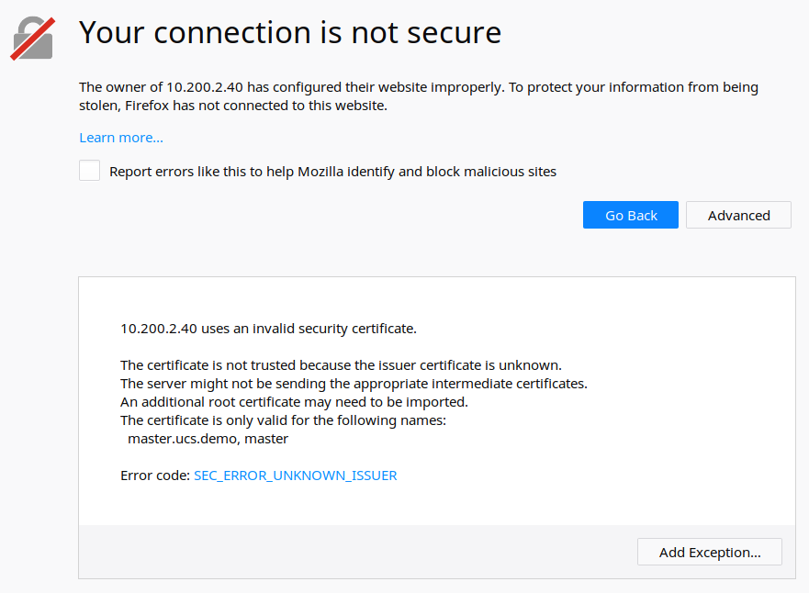
Issues: Unknown Certificate Authority
Notes:
“The certificate is not trusted because the issuer certificate is unknown.
The server might not be sending the appropriate intermediate certificates.
An additional root certificate may need to be imported.”

Slide 36
Issues: Unknown Certificate Authority
What if the browser doesn’t have the certificate authority’s public key for verification?
Warn the user that the website is not verified
The TLS connection can still proceed, but there is no guarantee that the user is talking to the legitimate server
What if the user is not talking to the legitimate server?
No more end-to-end security
An attacker can read and modify messages
An attacker can impersonate the server

Slide 37
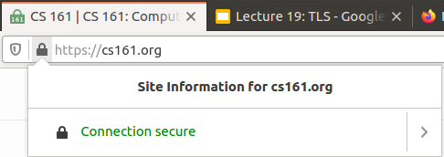
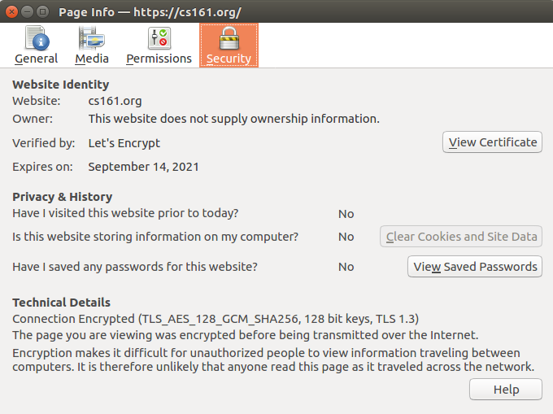
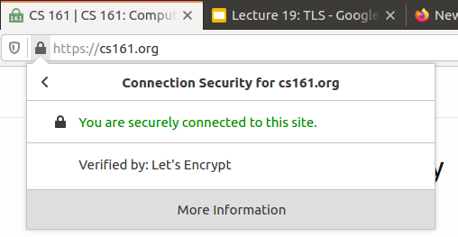
Verifying Certificates

Slide 38
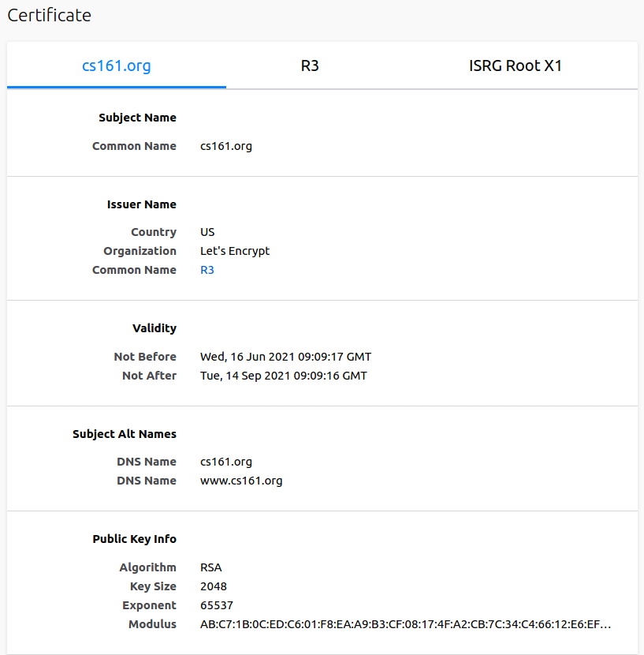
Verifying Certificates

Slide 39
Issues: Revocation
What if an attacker steals a server’s private key?
The certificate with the corresponding public key is no longer valid
TLS certificates have an expiration date, but they often don’t expire for years
Solution: Certificate revocation lists
The CA occasionally sends out lists of certificates that are no longer valid
The browser occasionally downloads the lists
Solution: Online Certificate Status Protocol (OCSP)
The browser queries the CA whether a given certificate is still valid
The CA responds either “good” or “revoked,” signed with the CA’s private key
Notes:
https://en.wikipedia.org/wiki/Online_Certificate_Status_Protocol

Slide 40
Issues: Trust Anchors
How many certificate authorities do we need to implicitly trust?
Modern browsers implicitly trust 100–200 root certificate authorities
A CA might issue a malicious certificate (e.g. stating that attacker’s public key belongs to Google) because:
The CA is hacked
An attacker pays the CA to issue a malicious certificate
Notes:
“Commercial certificate authorities protect you from anyone from whom they are unwilling to take money.” ~Matt Blaze (2001)
“A decade ago, I observed that commercial certificate authorities protect you from anyone from whom they are unwilling to take money. That turns out to be wrong; they don't even do that much.” ~Matt Blaze (2010)

Slide 41

Issues: Trust Anchors
 | Link
Solo Iranian hacker takes credit for Comodo certificate attack
Gregg Keizer | March 27, 2011
Security researchers split on whether 'ComodoHacker' is the real deal A solo Iranian hacker on Saturday claimed responsibility for stealing multiple SSL certificates belonging to some of the Web's biggest sites, including Google, Microsoft, Skype and Yahoo. Early reaction from security experts was mixed, with some believing the hacker's claim, while others were dubious.
Takeaway: Trust certificate authorities can be compromised by hackers
Notes:
https://www.computerworld.com/article/2507258/solo-iranian-hacker-takes-credit-for-comodo-certificate-attack.html

Slide 42

Issues: Trust Anchors
 | Link
Fraudulent Google certificate points to Internet attack
Elinor Mills | August 29, 2011
Is Iran behind a fraudulent Google.com digital certificate? The situation is similar to one that happened in March in which spoofed certificates were traced back to Iran. A Dutch company appears to have issued a digital certificate for Google.com to someone other than Google, who may be using it to try to re-direct traffic of users based in Iran. Yesterday, someone reported on a Google support site that when attempting to log in to Gmail the browser issued a warning for the digital certificate used as proof that the site is legitimate, according to this thread on a Google support forum site.
Takeaway: Trust certificate authorities can be compromised by hackers
Notes:
https://www.cnet.com/news/fraudulent-google-certificate-points-to-internet-attack/

Slide 43

Issues: Trust Anchors
 | Link
Final Report on DigiNotar Hack Shows Total Compromise of CA Servers
Dennis Fisher | October 31, 2012
The attacker who penetrated the Dutch CA DigiNotar last year had complete control of all eight of the company’s certificate-issuing servers during the operation and he may also have issued some rogue certificates that have not yet been identified.
Takeaway: Trust certificate authorities can be compromised by hackers
Notes:
https://threatpost.com/final-report-diginotar-hack-shows-total-compromise-ca-servers-103112/77170/

Slide 44

Issues: Trust Anchors
 | Link
Evidence Suggests DigiNotar, Who Issued Fraudulent Google Certificate, Was Hacked Years Ago
Mike Masnick | August 30, 2011
The big news in the security world, obviously, is the fact that a fraudulent Google certificate made its way out into the wild, apparently targeting internet users in Iran. The Dutch company DigiNotar has put out a statement saying that it discovered a breach back on July 19th during a security audit, and that fraudulent certificates were generated for "several dozen" websites. The only one known to have gotten out into the wild is the Google one.
Takeaway: Trust certificate authorities can be compromised by hackers
Notes:
https://www.techdirt.com/articles/20110830/13243615741/evidence-suggests-diginotar-who-issued-fraudulent-google-certificate-was-hacked-years-ago.shtml

Slide 45
Issues: Trust Anchors
DigiNotar: A certificate authority that was hacked
All web browsers removed DigiNotar from the list of trusted CAs
WoSign: An untrustworthy certificate authority
Also removed by all browsers
A user who controls nweaver.github.com can create certificates for any subdomain of github.com
Takeaway: It is hard to implicitly trust the root CAs (trust anchors) in TLS
Notes:
“Death sentence for CAs”
“And a bunch of other shady shenanigans”

Slide 46
Solving Trust Issues
Certificate pinning: The browser restricts which CAs are allowed to issue a certificate for each website
Example: Only the Google CA is allowed to sign certificates for Google websites
Now creating a fake certificate for a specific website requires attacking a particular CA
Certificate transparency: Public logs provided by CAs
Specifics are out of scope
High-level idea: Use hash chains to keep a record of all issued certificates
The server can tell the browser to only accept certificates from CAs implementing transparency

Slide 47
Solving Trust Issues
Other solutions implementing to “trust but verify” the certificate you received
EFF’s SSL Observatory: Check against certificates seen by other dedicated computers, called “observatories,” placed around the Internet
ICSI’s Certificate Notary: Check against certificates used in common Internet traffic, by tapping into common Internet channels

Slide 48
Certificate Authority Example: Let’s Encrypt
TLS requires every website to obtain and maintain certificates
Cost overhead: Certificates might cost money
Some management overhead involved
Let’s Encrypt: The world’s largest certificate authority
Issues certificates for free
Tries to make obtaining certificates as easy as possible
Steps of issuing a certificate (can all be automated with a script)
The server requests a certificate
Let’s Encrypt gives the server a file and tells the server to upload the file
The server uploads the file to the website
Let’s Encrypt verifies that the file has appeared on the website (thus verifying the server’s identity) and issues the certificate to the server

Slide 49
TLS: Summary
Client
Server
TLS Handshake
Nonces make every handshake different (prevents replay attacks across connections)
Certificate proves server’s public key
RSA or DHE proves that the server owns the private key
RSA or DHE helps client and server agree on a shared secret key
MAC exchange ensures no one tampered with the handshake
Messages are sent with symmetric encryption and MACs
Record numbers prevent replay attacks within a connection
ClientHello
ServerHello
Certificate
{gª mod p}K⁻¹server
Or RSA exchange
g^{b} mod p
{M, MAC(IB, M)}CB
{M, MAC(IS, M)}CS

Slide 50
TLS: Summary
Security properties
DHE TLS: Forward secrecy
RSA TLS: No forward secrecy
End-to-end security: Secure even if all intermediate parties are malicious
Not anonymous: Attackers can determine who you’re talking to
No availability: Connections can be dropped or censored
Can be used by the application layer (e.g. HTTPS)
Trusting certificate authorities can be hard

